Slide 1
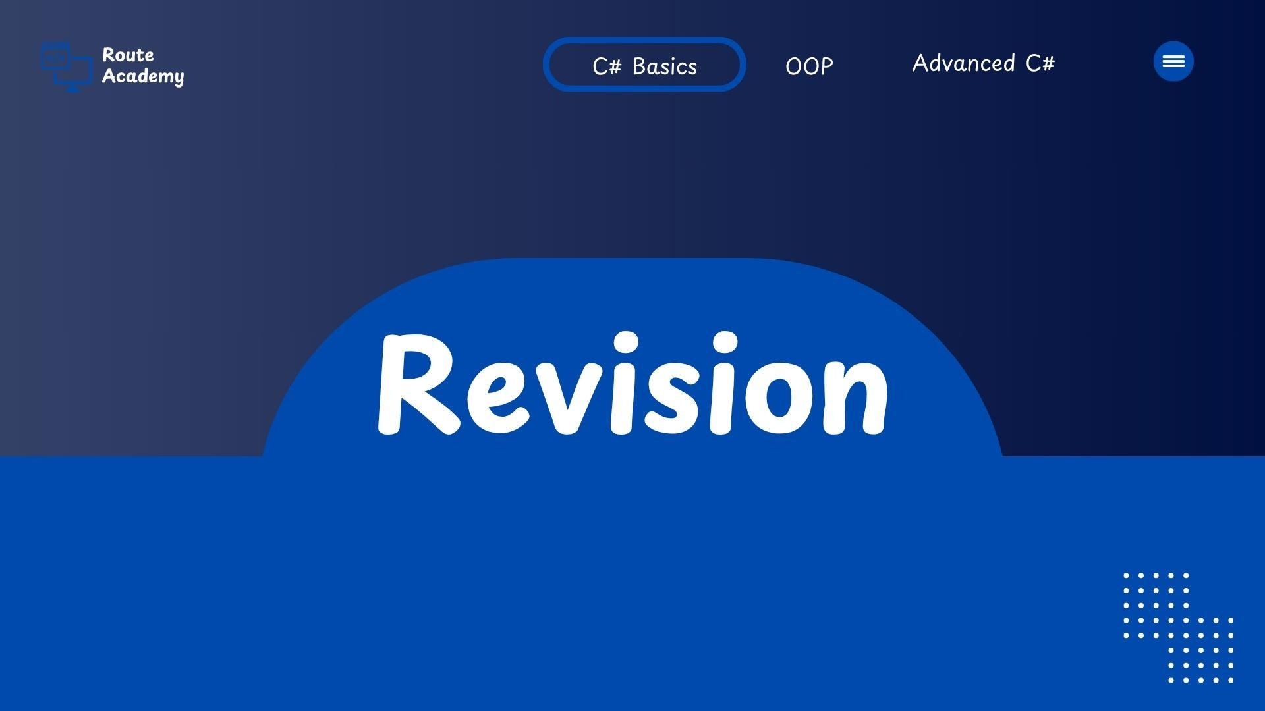
Notes:
int x = 200000;
byte y = (byte)x;
and try to print y the result will be 64 oops??
int x = 200000;
byte y = checked((byte)x);
and try to run it will give an exception that the data will lost
another way to write ckecked keyword
int x = 200000;
byte y;
checked
{y = (byte)x;}

Slide 2
Fractions And Discard
1. float (Single Precision Floating-Point)
Size: 4 bytes (32 bits).
Precision: Approximately 7 digits of precision.
2. double (Double Precision Floating-Point)
Size: 8 bytes (64 bits).
Precision: Approximately 15-16 digits of precision.
3. decimal (High Precision Floating-Point)
Size: 16 bytes (128 bits).
Precision: Approximately 28-29 digits of precision.

Slide 3
Casting
Casting refers to converting a value from one type to another. There are two types of casting in C#:
Implicit Casting
Implicit casting happens automatically when a smaller type is assigned to a larger type, and there is no risk of data loss.
Explicit Casting
Explicit casting (manual casting) is needed when converting from a larger type to a smaller type, or from an incompatible type . This can result a data loss or errors.
Notes:
int x = 200000;
byte y = (byte)x;
and try to print y the result will be 64 oops??
int x = 200000;
byte y = checked((byte)x);
and try to run it will give an exception that the data will lost
another way to write ckecked keyword
int x = 200000;
byte y;
checked
{y = (byte)x;}

Slide 4
Casting
Convert
Class provides methods to convert between types . It handles null values by converting to 0 and throws exceptions when the conversion is invalid or not supported.
Parse
Method is used to convert a string representation of a number into a numeric type , It Will throws exceptions when the string is not in a valid format or is null.
TryParse
Method is a safe alternative to Parse , Convert a string to a specified type and returns a boolean indicating success or failure. It does not throw exceptions.
Notes:
int x = 200000;
byte y = (byte)x;
and try to print y the result will be 64 oops??
int x = 200000;
byte y = checked((byte)x);
and try to run it will give an exception that the data will lost
another way to write ckecked keyword
int x = 200000;
byte y;
checked
{y = (byte)x;}

Slide 5
Operators
Unary
Binary
Assignment
Relational
Logical
Bitwise
Ternary
++
+
=
==
!
|
? :
--
-
+=
!=
&&
&
*
-=
>=
||
^
/
*=
<=
~
%
/=
>
<<
%=
<
>>

Slide 6
Operators Priority and Associativity
Priority | Operator | Associativity
1 | ( ) (parentheses) | Left-to-right
2 | ++, -- (post-increment, post-decrement) | Left-to-right
3 | ++, -- (pre-increment, pre-decrement) | Right-to-left
4 | !, ~ (logical NOT, bitwise NOT) | Right-to-left
5 | *, /, % (multiplication, division, modulus) | Left-to-right
6 | +, - (addition, subtraction) | Left-to-right
7 | <<, >> (bitwise shift left, shift right) | Left-to-right
8 | <, <=, >, >= (comparison operators) | Left-to-right
9 | ==, != (equality operators) | Left-to-right
10 | & , ^ , | , (bitwise AND , bitwise XOR , bitwise OR) | Left-to-right
11 | && , || (logical AND, logical OR) | Left-to-right
12 | ? : (ternary conditional) | Right-to-left
13 | =, +=, -=, *=, /=, %= (assignment operators) | Right-to-left
Operator priority and associativity determine the order in which operators are evaluated in an expression.

Slide 7
String Formatting
1. String Interpolation
String interpolation allows you to embed expressions inside string using curly braces {} and a dollar sign ($) before the string.
2. String.Format Method
method allows you to insert placeholders into a string template and replace them with values at runtime.
3. Composite Formatting
Composite formatting is similar to String.Format, but it’s a simpler way to use placeholders directly within Console.WriteLine
4. String Concatenation
You can concatenate strings using the + operator or the string.Concat() method. However, string concatenation is not the most efficient method for complex string operations due to the immutability of strings in C#.

Slide 8
Control Statements
Used to control the flow of execution in a program. They allow you to make decisions, loop over collections, or execute blocks of code conditionally.
Conditional | Selection Statements
Control statements allow the program to make decisions based on conditions and execute different blocks of code depending on whether a condition is true or false.
1.1 if Statement
statement evaluates a condition and executes the associated block of code if the condition is true.
1.2 else Statement
The else statement is used to provide an alternative block of code when the if condition is false.
1.3 else if Statement
The else if statement allows for multiple conditions to be checked sequentially.
1.4 switch Statement
The switch statement is used to select one of many code blocks to be executed based on the value of a variable.

Slide 9
Conditional Statements
Control statements allow the program to make decisions based on conditions and execute different blocks of code depending on whether a condition is true or false.
1.1 if
1.2 else
1.3 else if
if (condition1)
{ // Code block if condition1 is true }
else if (condition2)
{ // Code block if condition2 is true }
else
{ // Code block if neither condition1 nor condition2 is true }
Syntax

Slide 10
Conditional Statements
1.4 Switch
switch (expression)
{
case value1:
// Code block executed if expression == value1
break;
case value2:
// Code block executed if expression == value2
break;
case value3:
// Code block executed if expression == value3
break;
default:
// Code block executed if none of the cases match
break;
}
Syntax

Slide 11
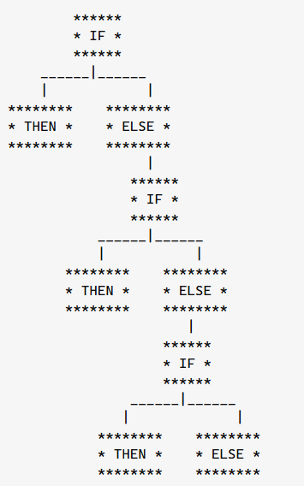
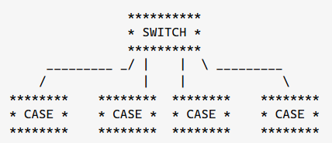
Conditional Statements
if
switch
A switch only needs to take one step
if falls through 3 separate if cases

Slide 12


Slide 13
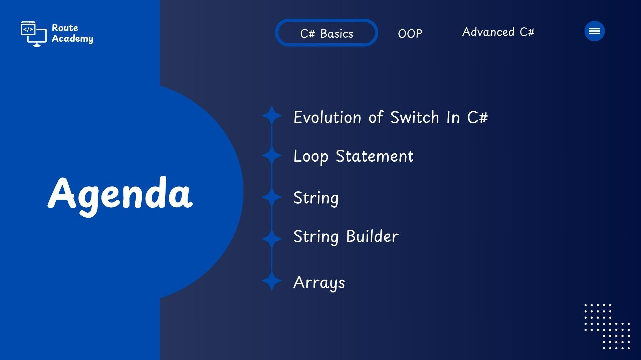

Slide 14
Evolution of switch in C#
Initial Version (C# 1.0 - C# 6.0)
The switch statement was quite basic and worked only with integral types such as int, char, byte, short, long, or enumerations.
It could only handle primitive types or enums
Only constant expressions are allowed in case labels.

Slide 15
Evolution of switch in C#
The switch statement in C# has evolved significantly over time, becoming more powerful and expressive
C# 7 : introduced pattern matching, making switch statements more flexible.
starting with C# 7 we can use pattern matching with switch cases and another feature that comes with pattern matching is case guards.
the switch statement could perform pattern matching on types and values

Slide 16
Evolution of switch in C#
C#8 : Came with a whole new exciting thing called “Switch Expressions” , Enhance Pattern matching to Work without alias name , can work with nullable types and Limited support for relational Patterns [Partially]
string result = option switch
{
"1" => "Using Option 1",
"2" => "Using Option 2",
"3" => "Using Option 3",
_ => "Unsupported option",
};
Syntax
Switch expressions can be Constant pattern , Discard pattern , Property pattern

Slide 17
Evolution of switch in C#
C# 9 : Switch expressions Features extended using new patterns introduced like Relational patterns [Fully Introduced ] , Logical patterns and enhanced property patterns .
Relational patterns : allow you to use relational operator(<, >, <= or >=) in your expression to match the pattern
Logical patterns : in C# 9 allow you to use one or more logical operators (not, and, or) in your expression to match the pattern

Slide 18


Slide 19
Control Statements
2. Looping | Iteration Statements
Looping statements are used to repeat a block of code multiple times until a specific condition is met
2.1 for Loop
The for loop is used when the number of iterations is known beforehand.
2.2 while Loop
The while loop executes as long as the specified condition is true. The condition is evaluated before each iteration
2.3 do-while Loop
The do-while loop is similar to the while loop, but the condition is evaluated after the loop's body, meaning the block of code will always execute at least once.
2.4 foreach Loop
The foreach loop is used to iterate over collections such as arrays, lists, or other enumerable types.

Slide 20
Looping | Iteration Statements
Console.WriteLine(1);
Console.WriteLine(2);
Console.WriteLine(3);
Console.WriteLine(4);
Console.WriteLine(5);
Console.WriteLine(6);
Console.WriteLine(7);
Console.WriteLine(8);
Console.WriteLine(9);
Console.WriteLine(10);
10 Statements [10 step ]

Slide 21
Looping | Iteration Statements
2.1 for Loop
1. i = 1
2. i <= 10 // true
3. print (1)
for (int i = 1; i <= 10; i++)
{
Console.WriteLine(i);
}
……..
……..
28. i ++ // i = 10
29. 10 <= 10 // True
30. Print(10)
31. i ++ // i = 11
32 Statements [32 step ]
32. 11 <= 10 // False

Slide 22
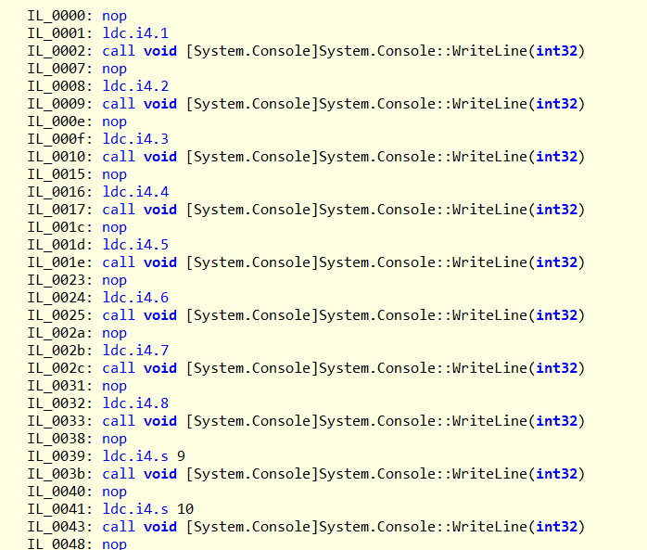
Looping | Iteration Statements
Manual Code Repetition IL :

Slide 23
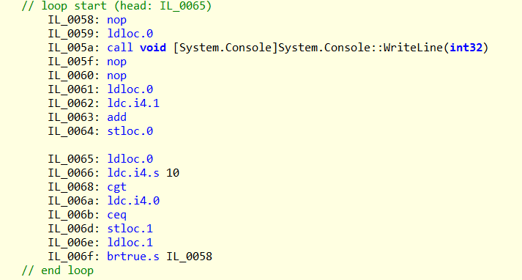
Looping | Iteration Statements
for Loop IL :

Slide 24
Looping | Iteration Statements
for (initialization; condition; increment/decrement)
{
// Code to execute during each iteration
}
for
foreach (var item in collection)
{
// Code to execute for each item
}
foreach

Slide 25
Looping | Iteration Statements
for & foreach
POV | for | foreach
Performance | faster | slightly slower
Collection Modification | Can modify the collection or elements | Cannot modify the collection during iteration.
Access To Index | Has access to the index of each element | Does not provide access to the index

Slide 26
Looping | Iteration Statements
while
{
// Code to execute
}
while
do
{
// Code to execute
} while (Condition)
do-while

Slide 27
Looping | Iteration Statements
while & do-while
POV | while | do-while
Condition Check | Condition is checked before the loop starts | Condition is checked after the loop runs
Execution | The loop may not execute if the condition is false initially. | The loop always executes at least once.
Use Case | you want the loop to execute only if the condition is true at the start. | when the loop should run at least once, regardless of the condition.

Slide 28
Looping | Iteration Statements
For
while
For each
do-while
Medium

Slide 29


Slide 30
String
Is a Built in Class [Reference Data Type] and represented as a sequence of characters.
They are immutable [once a string object is created, its value cannot be changed]
Any operation that modifies a string actually creates a new string object, leaving the original string unchanged.
Internally is represented as an array of characters. Each character in the string corresponds to a single char element in an array, where each char needs 2 Bytes.

Slide 31
String
String name1 = “Amr”;
String name2 = “May”;
Name2 = Name1; //Amr
name02
M a y
Name1 = “Omar”;
A m r
Console.Writeline(Name1); // Omar
name01
O m a r
Console.Writeline(Name2); // Amr
Stack
Heap

Slide 32


Slide 33
Stringbuilder
Is a Built in Class [Reference Data Type] and represented as a sequence of characters.
It is a mutable string [if an object of stringbuilder is created, its value can be changed]
Internally is represented as a linked list of characters.

Slide 34
Stringbuilder
StringBuilder Message = New StringBuilder();
Message.Append = “Hello”;
Message.Append = “ Route”;
Console.Writeline(Message); // Hello Route
Message
Hello
Hello Route
Stack
Heap

Slide 35


Slide 36
Array
Is a data structure that holds a fixed-size sequence of elements of the same type.
Arrays allow you to store multiple values in a single variable.
they are very useful when you need to work with collections of data that are related in some way
Characteristic of Array in C# :
Fixed Size
Same Data Type
Zero-based Indexing
Once array is created. You can’t change it during runtime (unless you create a new array)
All elements in an array must be of the same type (all ints, all strings)
Meaning that the first element is at index 0

Slide 37
Array
Types of Array in C# :
One Dimensional Array
Multidimensional Array (2D , 3D)
Jagged Array

Slide 38
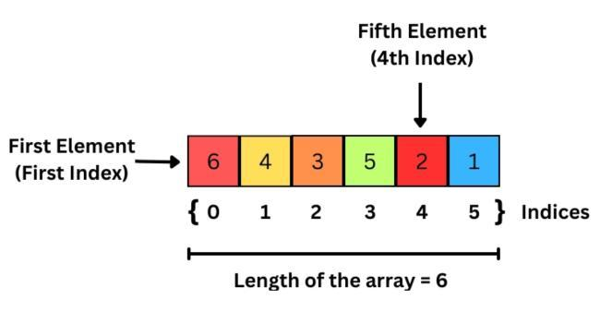
Array
One Dimensional Array :

Slide 39
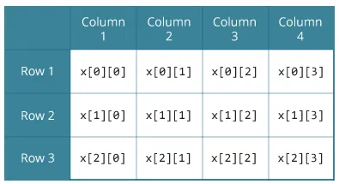
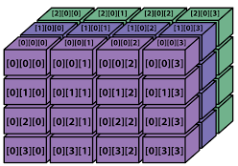
Array
Multidimensional Array :
2D Array
3D Array

Slide 40
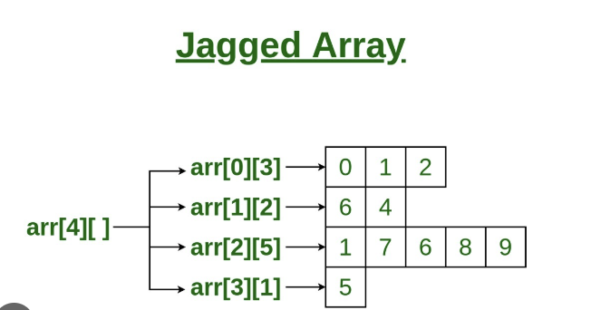
Array
Jagged Array :

Slide 41
One Dimensional Array
int [] Numbers ;
Numbers = new int [3];
Numbers [1] = 50;
12 Bytes
Numbers[1] ; // 50
0
0
0
0x0008
0X0004
0X0000
0
50
0
1 * 4 = 4 + Base Address => 0X0004
Numbers NULL
Numbers[3] = 10 ;
0X0000
3 * 4 = 12 + Base Address => 0X00012
Stack
Heap

Slide 42
Two D Array [Rectangular]
Row Column
int [ , ] Marks = new int[3 , 5];
Sub 1 Sub 2 Sub 3 Sub 4 Sub 5
0 1 2 3 4
100 | 90 | 100 | 90 | 89
99 | 88 | 100 | 70 | 90
80 | 75 | 89 | 78 | 100
Student 1 0
Student 2 1
Student 3 2
Marks [ 1 , 2 ] =
100

Slide 43
Jagged Array
Add. OF Array 01
Add. OF Array 02
Add. OF Array 03
One Dimension Array Of Arrays

Slide 44
Array Methods
Class member Methods
Array.Sort() : Sorts the elements of the array in ascending order.
Array.Reverse() : Reverses the order of the elements in the array.
Array.Copy() : Copies a range of elements from one array to another.
Array.Clear() : sets elements of the array within a specified range with the default value.
Array.IndexOf() : Finds the index of the first occurrence of a specified value in the array.
Array.LastIndexOf() : Finds the index of the last occurrence of a specified value in the array.
Array.Resize() : creates a new array and copies the elements from the old array to the new one

Slide 45


Slide 46


